Slide 1


Slide 2
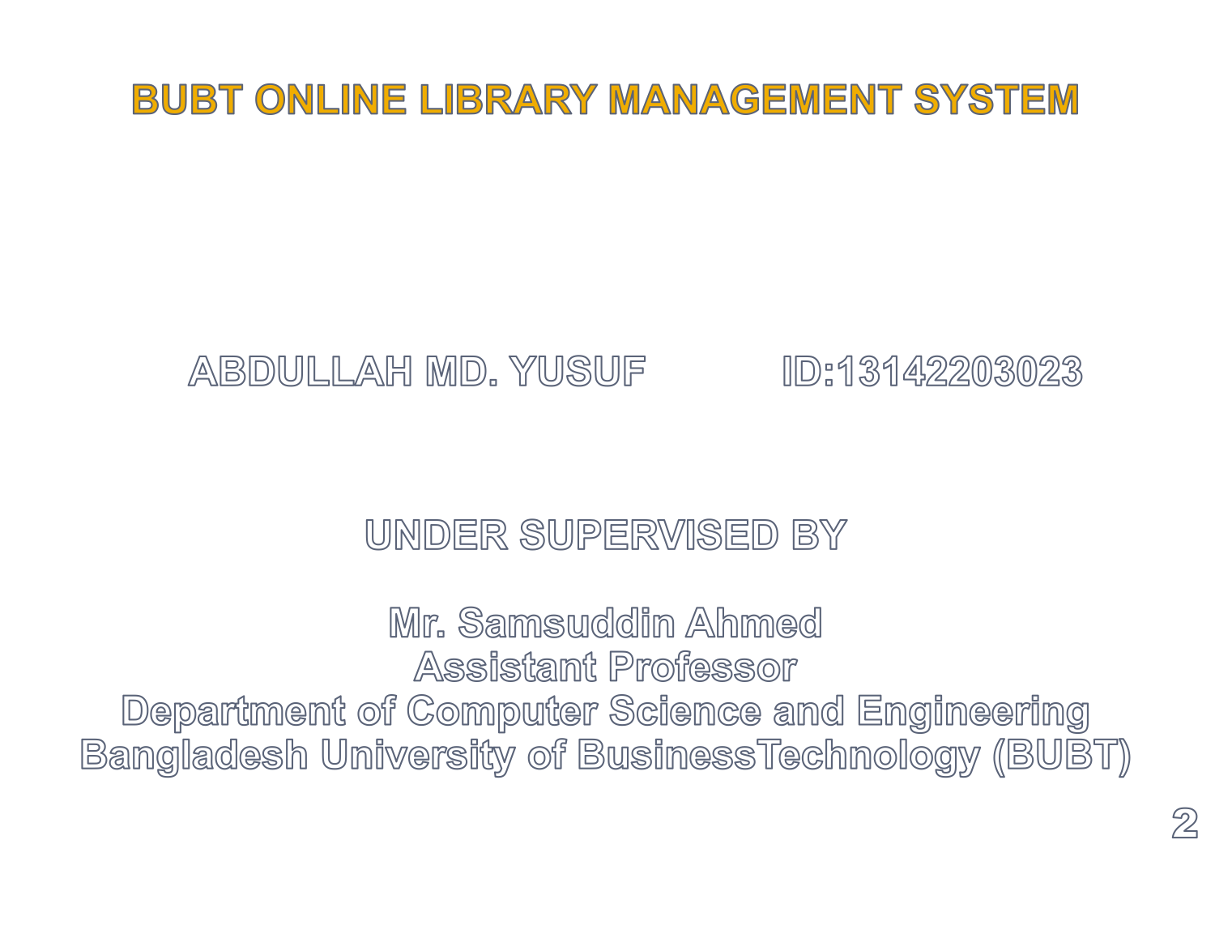
Presented by

Slide 3
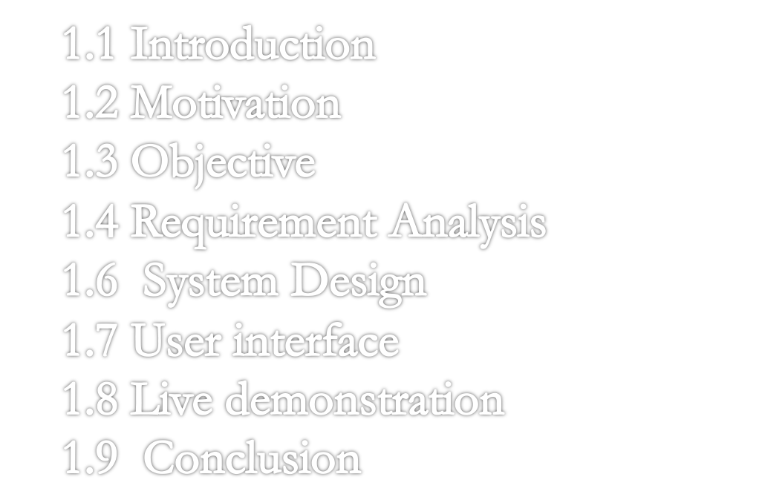
BUBT ONLINE LIBRARY MANAGEMENT SYSTEM
2

Slide 4

The main objective of the Library Management system is organizing and managing the library tasks. Library is place where all kind of books are available. This is a web base application and only a registered user can access the application. This system provides separate interface and login for librarian, students and faculties.

Slide 5

The loss of time and money engendered by the inefficient operations in most section of the library, particularly in record kepping of both hard and soft copies of books, monitoring the stock and performing daily book transactions such as issuing books, discharging books, reserving books and downloading available PDF-books in both sections of the library motivated me in carrying out this project.The aim of this project is to develop a multi-platform online library management system that can both handle and manage the daily activities carried out in the library in an effcient and reliable manner.

Slide 6
OBJECTIVES
More accuracy.
Speed improvement.
Data inconsistency.
Better error handling.
Integrity.
It handles entire transaction of book register till issue of the book.
Administrator will immediately acknowledge with error message.
Book search can be performed.
3

Slide 7


Efficiency requirement
Reliability requirement
Usability requirement
Implementation requiremnts

Slide 8

User Login
Register New User
Register New Book
Search Book
Issue Books and Return Books
Auto fine calculation

Slide 9

User registration with form validation
Login
Search book
Issue book
Fine calculation
Individual notice
General notice
Update profile
5

Slide 10

Data Flow Diagram
Entity Relational Diagram
Database Design

Slide 11
Discuss About DFD Elements
  Data Flows
    Data in motion
    Marks movement of data through the system - a pipeline to carry data.
    Connects the processes, external entities and data stores.
    Generally unidirectional, If same data flows in both directions, double-headed arrow can be used.
Data Flow
Fig: Data flow

Slide 12
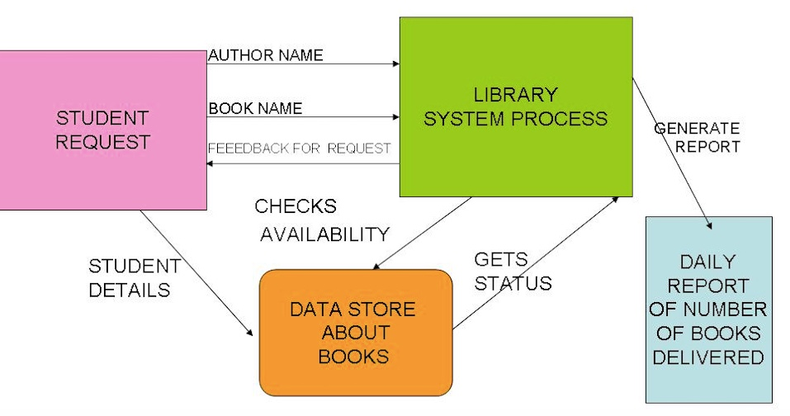
  DATA FLOW DIAGRAM (DFD)
6

Slide 13
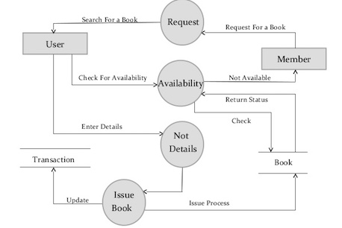
  DATA FLOW DIAGRAM (DFD)
6

Slide 14
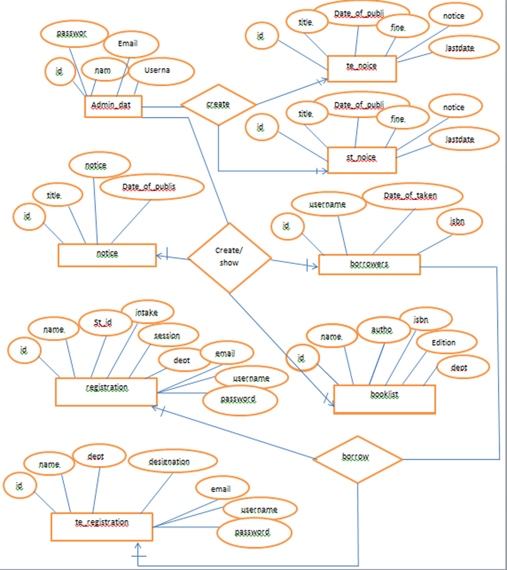
E-R Diagram
Fig: Data store

Slide 15

    Modify Book (Librarian)
    Check and Update Database (Librarian)
    Calculate Fine (Librarian)
    Display Status (Librarian, Student)
    Request Book (Student)
    Reserve Book (Student)
    Issue Book (Student)
    Return Book (Student)
    Show Fine (Student)

Slide 16


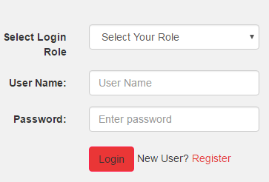
Login
Librarian
Student

Slide 17



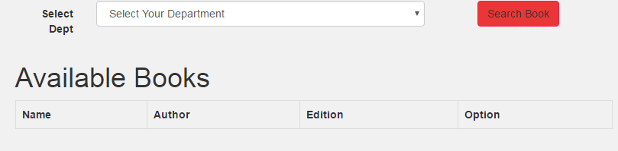
Search Book
Librarian
Student
Librarian and Student can search book and it
Give a status like search complete book found
Display Status

Slide 18



Reserve Book
Data Store
Student
Display Status
Student can reserve more than one book

Slide 19



Issue Book
Data Store
Student
Display Status
If any student want to read
book it must be issue first

Slide 20

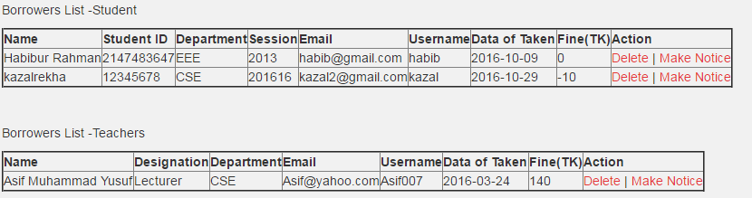
Show Fine
Data Store
Student
Student can show his/her fine for delay return book
Display Status

Slide 21

Now we are going to show our project on the local server.

Slide 22

Library Management System of the entire system improves the efficiency.
It provides a friendly graphical user interface which proves to be better when compared to the existing system.
It gives appropriate access to the authorized users depending on their permissions.

Slide 23

Updating of information becomes so easier.
System security, data security and reliability are the striking features.
The System has adequate scope for modification in future if it is necessary.

Slide 24

Although the designed websites are designed perfectly to run immediately, but this is under construction. This construction depends upon users what she/he needs. Should further time have been available.

Slide 25
It would have been desirable to address the following issues:
Automatic notification
Search by author and book name
Android App
Dynamic book restore
IPhone app

Slide 26
Thanks to all

